Slide 1
STUDENT MARKSHEET GENERATER
Using C programming…..

Slide 2
First look of program..
1. ADD STUDENT MARKSHEET
2. VIEW STUDENT RECORD
3. VIEW STUDENT MARKSHEET
4. SEARCH STUDENT MARKSHEET
5. EXIT
Enter Your Choice:-

Slide 3
1. ADD STUDENT MARKSHEET
<--------Enter Your Basic Details---------->
Enter your Roll no:- 1
Enter your name:- Kundan Kumar
Enter your Father name:- Virender Prajapati
Enter your Date of Birth:- 24 Sep 2004
Enter your Course Name:- BCA
Enter your Sem/Part:- 2

Slide 4
1. ADD STUDENT MARKSHEET
<--------Enter Your Subject Marks---------->
Enter C programming Marks: 98
Enter LOC Marks: 99
Enter MFCS Marks: 89
Enter SSAD marks: 79
Enter Software Lab Marks: 89

Slide 5
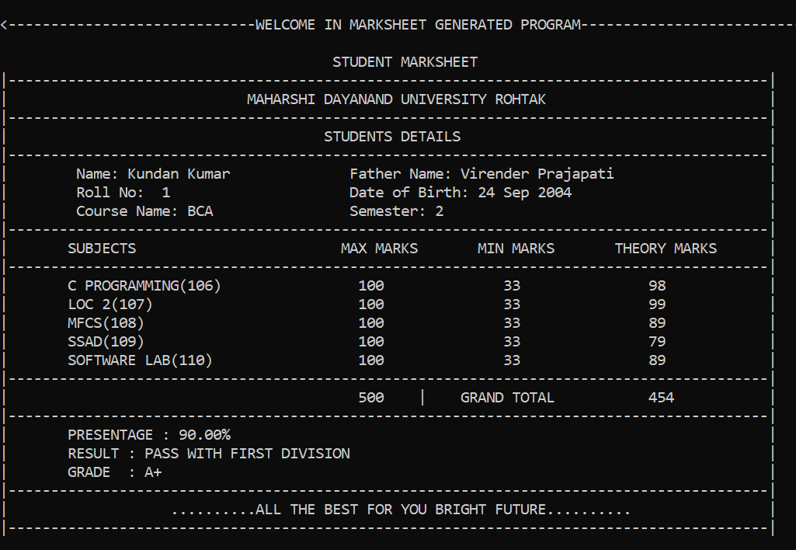
Generated Marksheet Report

Slide 6

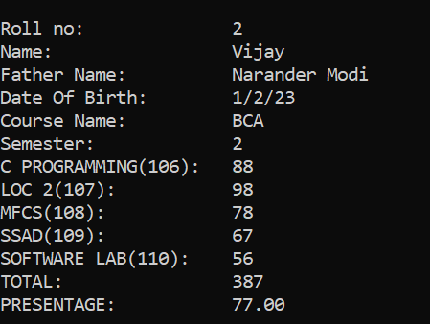
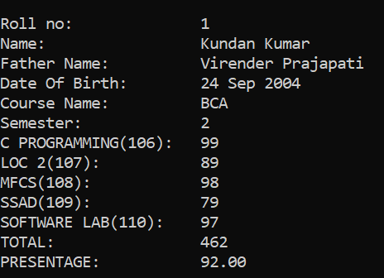
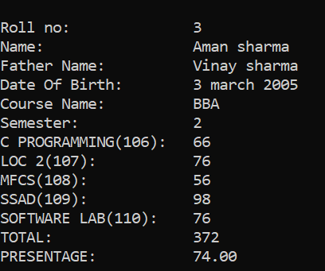
2. VIEW STUDENT RECORD

Slide 7

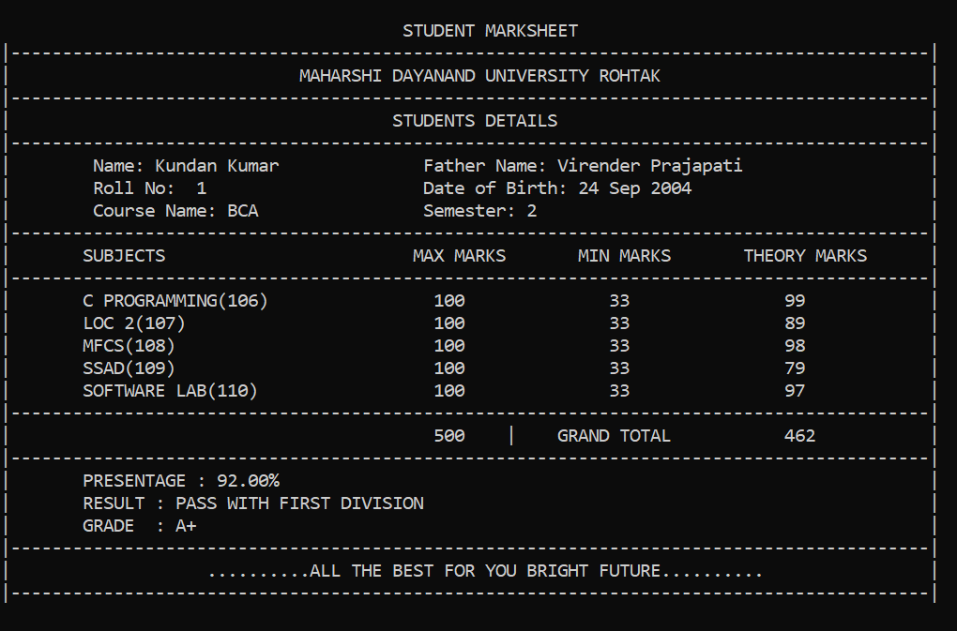
3. VIEW STUDENT MARKSHEET

Slide 8

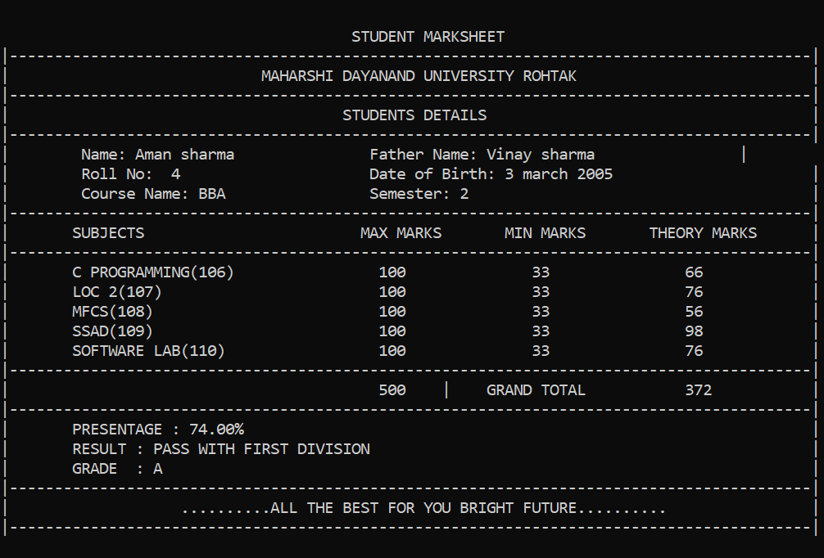
4. SEARCH STUDENT MARKSHEET

Slide 9
5. EXIT
This function is used to exit form the program..

Slide 10
…..Thank You…..
Programmed By Kundan and Vijay..

